Slide 1
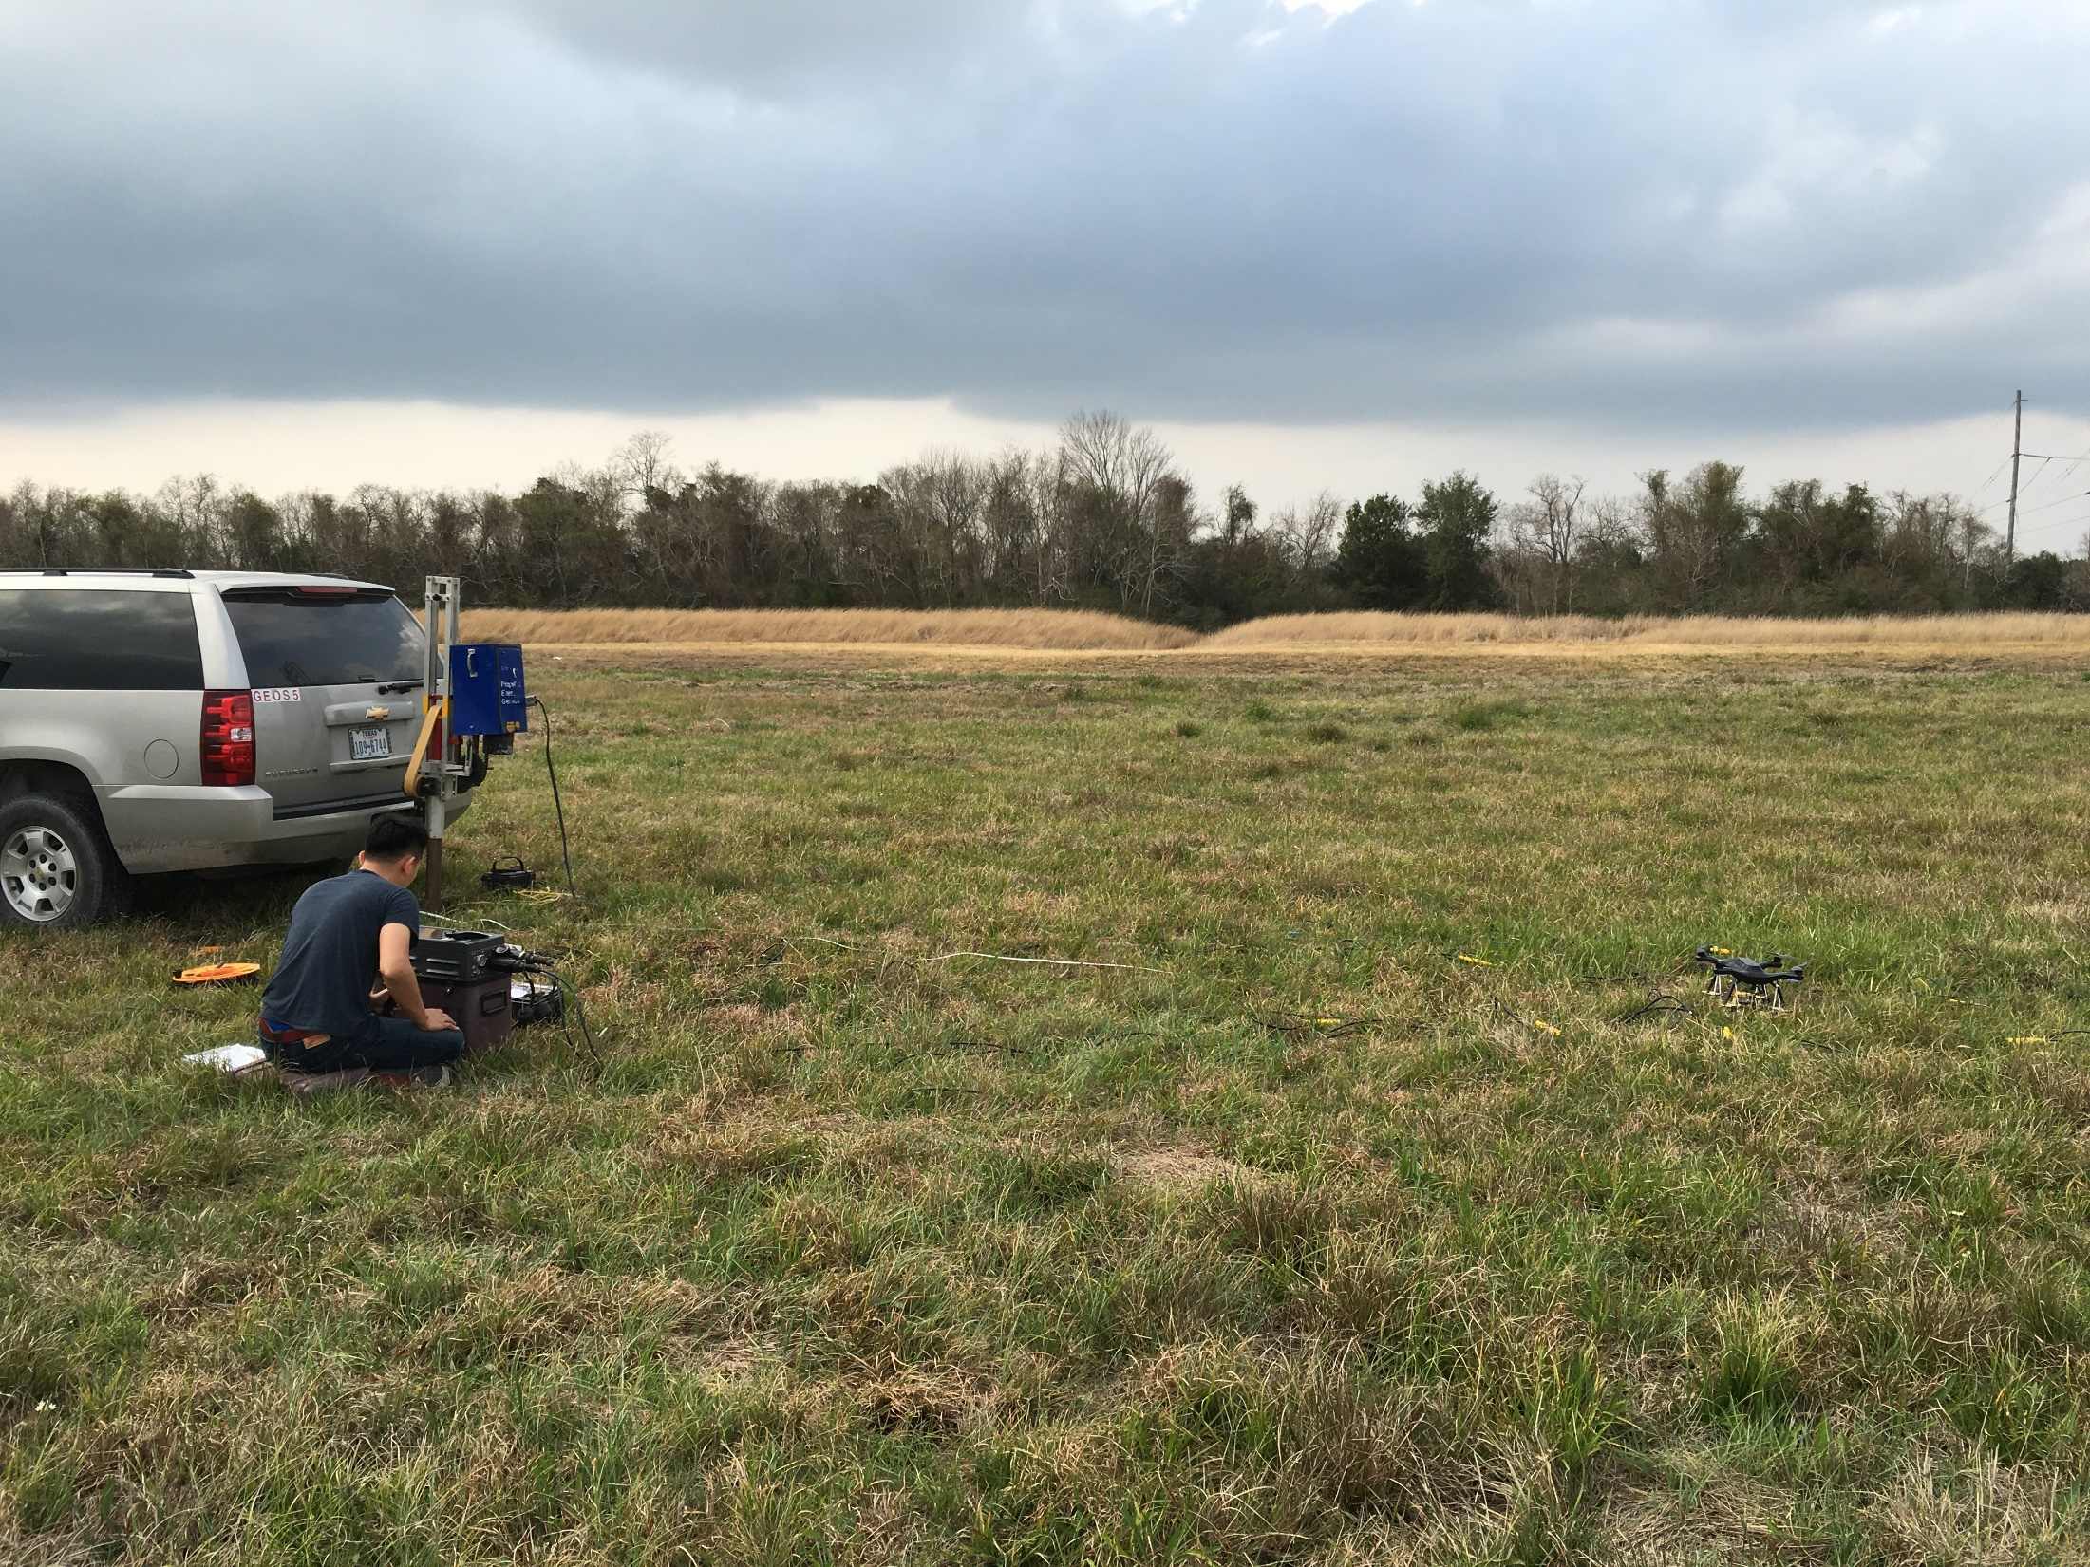
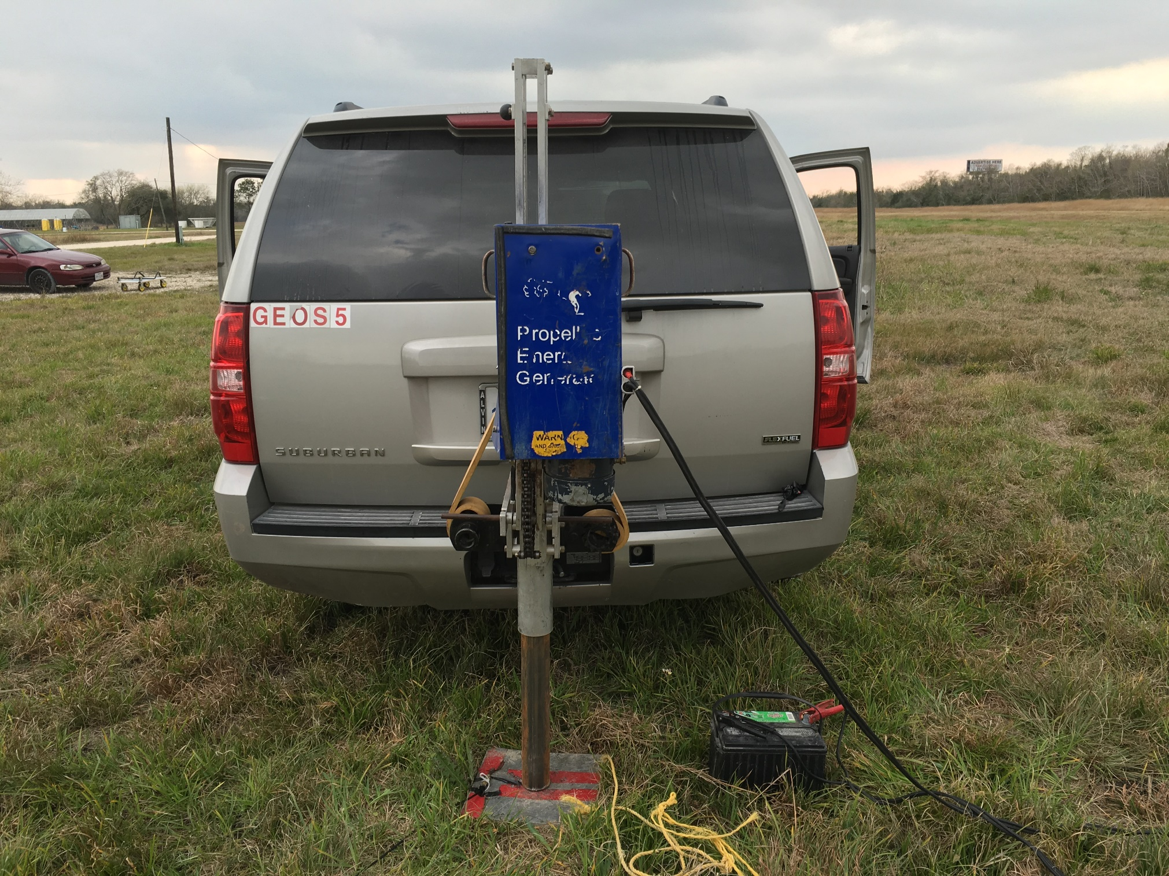
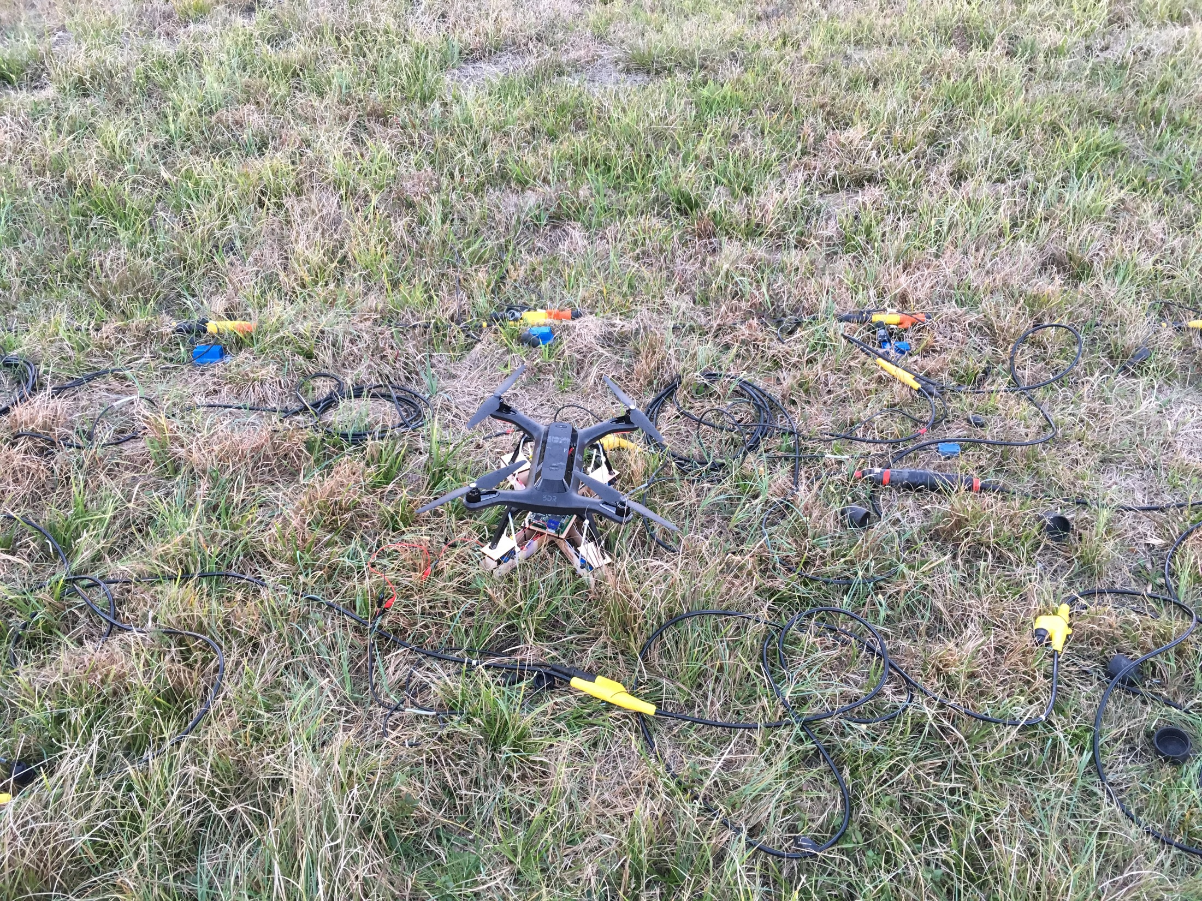
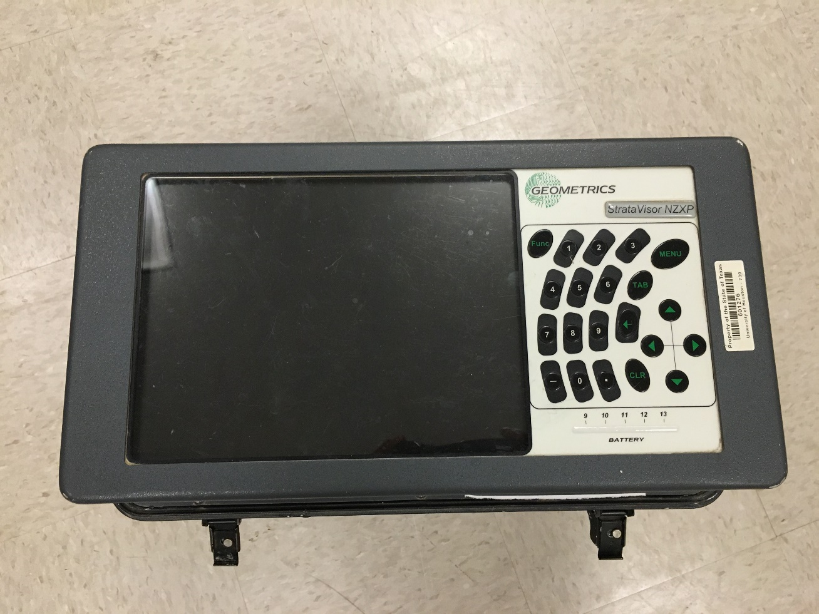
a.
b.
c.
a.
Vibrating truck setup (motor + battery + piston)
b.
Traditional cabled system
c.
Metal
plate
SeismicDrone

